Slide 1
PFAS In and Around Lake Boon:
Presented by:
Kirk Westphal
Lake Boon Association, Science Advisor
September 20, 2023
Health Risks
Relevant Regulations
Actions to Consider

Slide 2
Purpose of this discussion
Explain the propagation of PFAS in and around Lake Boon, and its health risks
Present relevant local, state, and federal regulations and what they mean to us
Discuss options for action

Slide 3
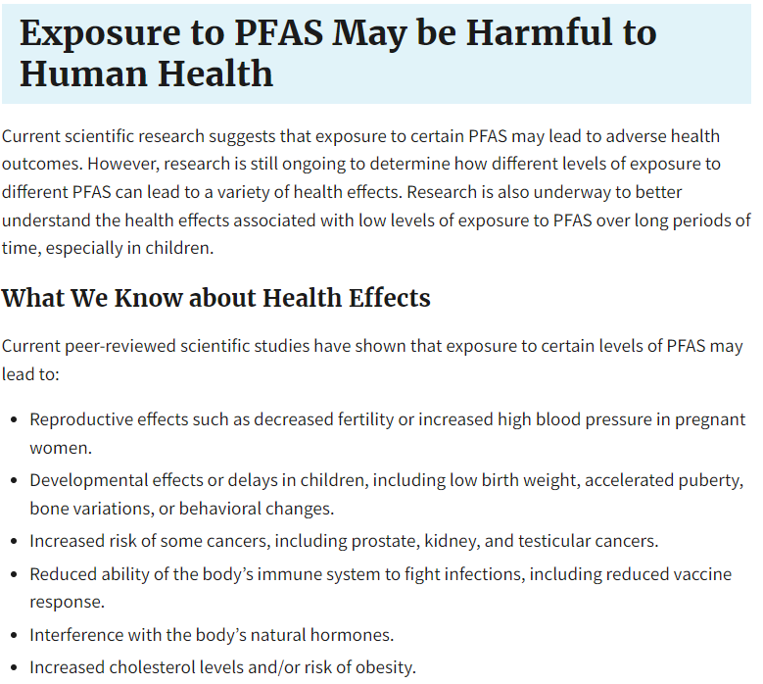
https://www.epa.gov/pfas/our-current-understanding-human-health-and-environmental-risks-pfas
PFAS and Health Risks
PER US EPA
What is PFAS?
Per- and polyfluoroalkyl substances (PFAS)
Manufactured chemicals that make products resistant to stains, water, sticking, etc.
Used in firefighting foam
Termed “Forever Chemicals” because they do not break down quickly
Measured in Parts Per Trillion (ppt)
A grain of sand in an Olympic size pool
30 seconds in a million years
Opportunities to learn more:
MOVIE: Dark Waters (2019): True story of legal action against DuPont Chemical Company
BOOK: Troubled Waters: What’s Wrong with What We Drink: Seth M. Siegel (2019)
The Lake Boon Association offers these opportunities to learn for educational value without necessarily endorsing either.

Slide 4
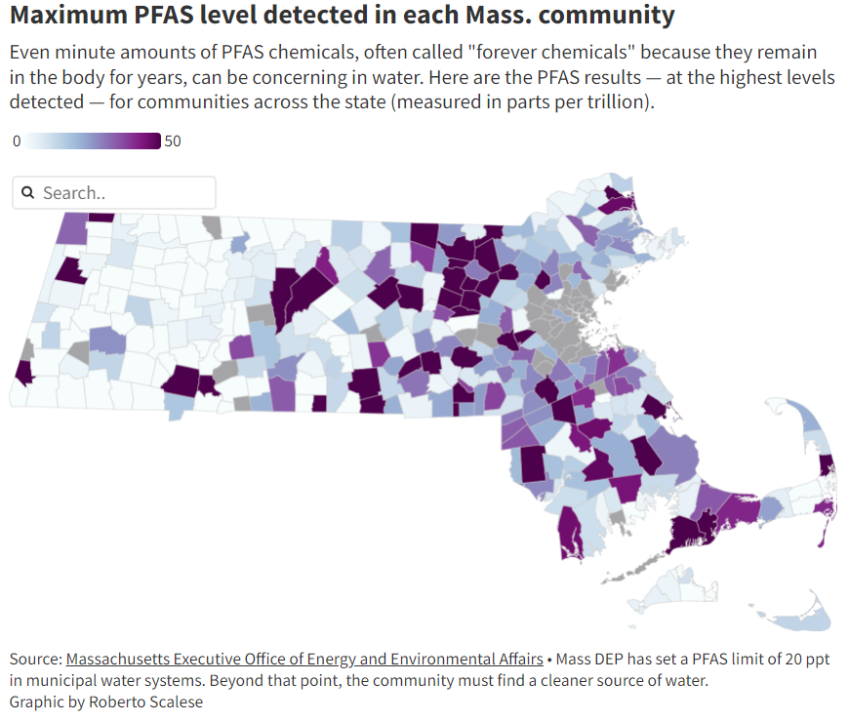
Where is PFAS in Massachusetts
US Geological Survey: Concentrations of Per- and Polyfluoroalkyl Substances (PFAS) in Selected Rivers and Streams in Massachusetts, 2020
27 Rivers in MA
Near wastewater plants
Near industrial discharge
In open areas
PFAS detected in all 27 rivers
https://pubs.usgs.gov/publication/dr1160
(Temporarily unavailable)
Stow
Hudson
PFAS is ubiquitous throughout the environment. Around Lake Boon we are particularly vulnerable because of the Firefighting Academy on Sudbury Road in Stow.
https://www.wbur.org/news/2023/02/14/pfas-pfoa-massachusetts-drinking-water-clean-up

Slide 5
Statement of Facts
PFAS Contamination
PFAS Regulations
PFAS are widely used, long lasting chemicals, components of which break down very slowly over time (https://www.epa.gov/pfas/pfas-explained)
Scientific studies have shown that exposure to some PFAS in the environment may be linked to harmful health effects in humans and animals. (https://www.epa.gov/pfas/pfas-explained)
The DFS Firefighting Academy on Sudbury Road in Stow is a known source of PFAS, which is a chemical used in firefighting foam. It is likely not the only source of PFAS in the Lake Boon watershed and aquifers.
PFAS has been detected in White Pond, Lake Boon, and in private drinking water wells around Lake Boon
PFAS can be effectively treated by public treatment plants or in-home systems using carbon filters or reverse osmosis systems.
PFAS Regulations are relatively new and still evolving – each state does this differently.
Massachusetts limits PFAS concentrations in drinking water to 20 parts per trillion (ppt), as a combination of 6 identified compounds.
The US EPA has promulgated regulations that would supercede state regulations, and limit PFAS in drinking water to 4 ppt for PFOA and PFOS (2 PFAS compounds commonly in firefighting foam) and 4 others. The public comment period ended in mid 2023. Generally expected to be enacted in 2023.
The Stow Board of Health has drafted regulations that may require homeowners to pay the cost of PFAS remediation for their homes
PFAS has been detected in Lake Boon and adjoining wells at levels that exceed current MA drinking water regulations and pending EPA drinking water regulations.

Slide 6
Timeline and levels of PFAS occurrence in Lake Boon
Note: Much of this information is extracted from
a cited report commissioned by the Massachusetts
Department of Environmental Protection, which focuses on the impacts of PFAS to nearby ecosystems. By its charter, MADEP is responsible for ecosystem and environmental health, but does not have specific oversight of human health, per se. The numbers in MADEP’s report, however, are alarming with respect to human health risks.

Slide 7
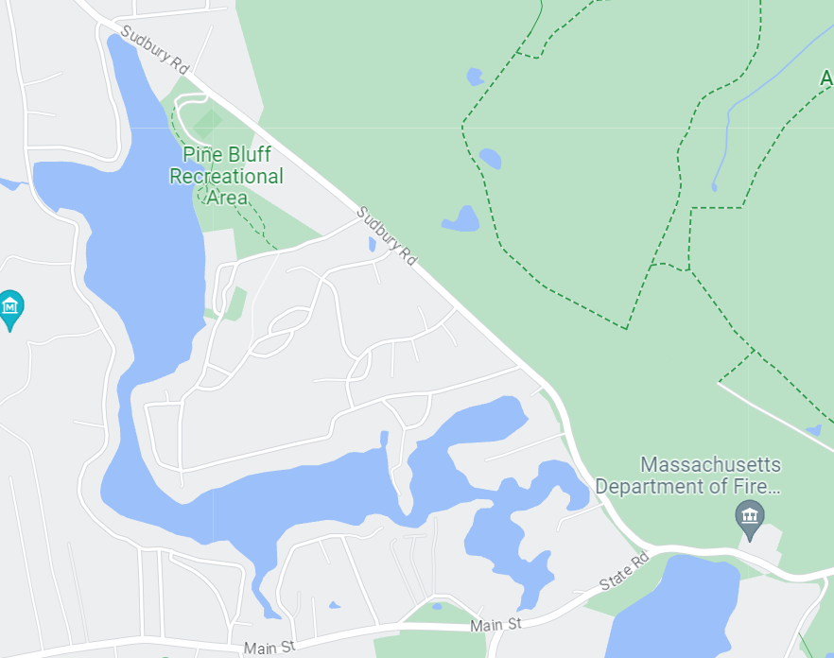
2018
Cited by DEP,
“obtained by others.”
Cited in:
Immediate Response Action Status Report No. 7, MA DFS Firefighting Academy, 664 Sudbury Road, Stow MA. Release Tracking Number 2-21045. MA Department of Environmental Protection, February 27, 2023. Prepared by GZA
68 ppt

Slide 8
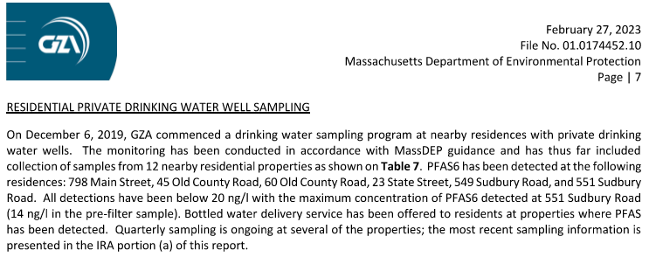
Levels in private wells
2019
Immediate Response Action Status Report No. 7, MA DFS Firefighting Academy, 664 Sudbury Road, Stow MA. Release Tracking Number 2-21045. MA Department of Environmental Protection, February 27, 2023. Prepared by GZA
Non-Detect
< 20 ng/l

Slide 9
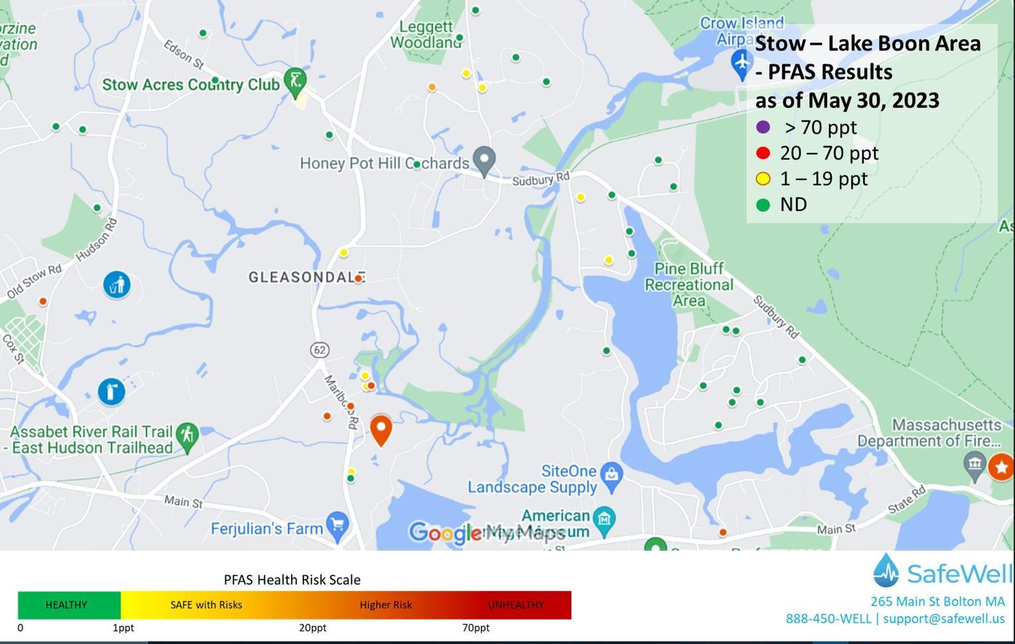
2019-2023
Levels in private wells
Measurements taken between 2019-2023:
Individual wells on a volunteer basis

Slide 10
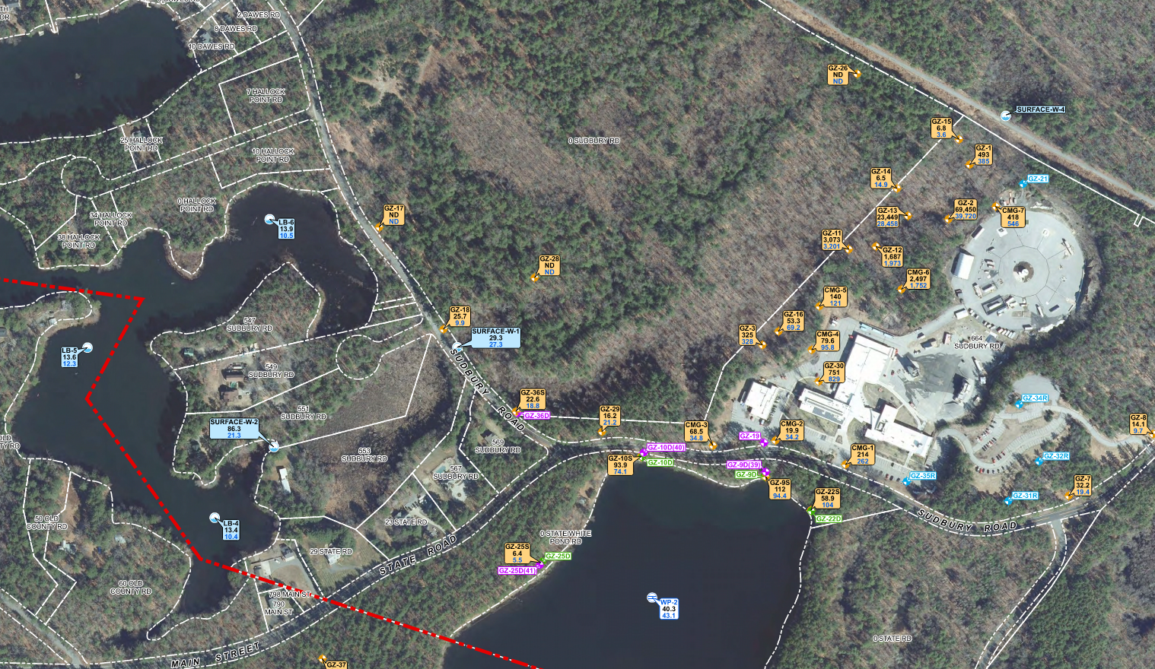
Levels in and around the Firefighting Academy
2022
39,720 ppt
3,201 ppt
28,458 ppt
Immediate Response Action Status Report No. 7, MA DFS Firefighting Academy, 664 Sudbury Road, Stow MA. Release Tracking Number 2-21045. MA Department of Environmental Protection, February 27, 2023. Prepared by GZA
DEP Figure 7A

Slide 11
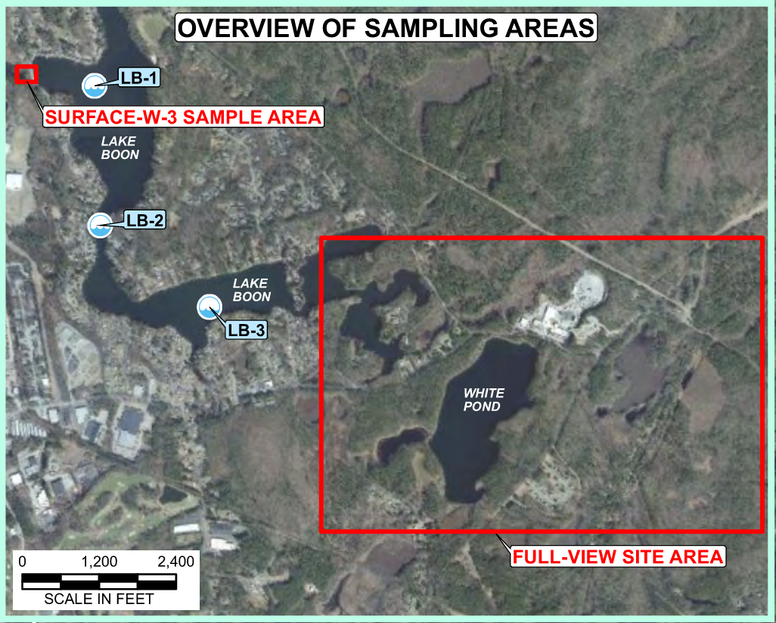
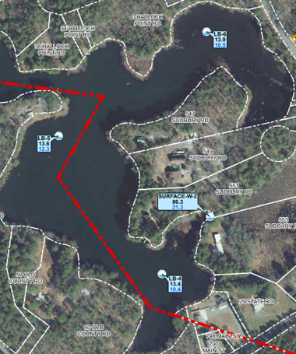
PFAS Levels in Lake Boon
Immediate Response Action Status Report No. 7, MA DFS Firefighting Academy, 664 Sudbury Road, Stow MA. Release Tracking Number 2-21045. MA Department of Environmental Protection, February 27, 2023. Prepared by GZA
2021-2022
(25.4 in 2021)
DEP Figure 2 and Table 5
12.9-25.4 ppt
12.1-13.1 ppt
10.5-13.9 ppt
12.3-14.8 ppt
12.7-13.7 ppt
11.9-14.4 ppt
21.3-86.3 ppt
10.4-14.9 ppt

Slide 12
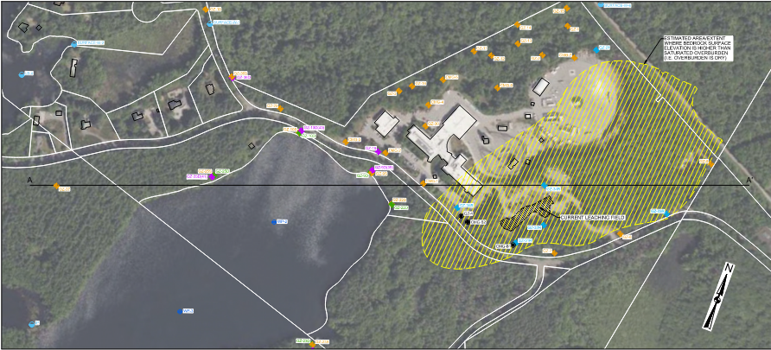
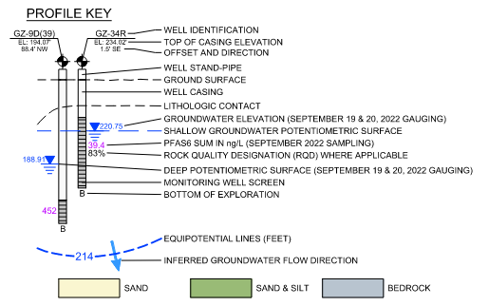
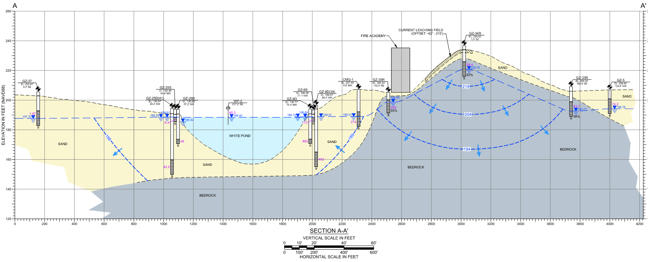
Levels in groundwater near White Pond
A
A
DEP Figure 8A
112 ppt
214 ppt
482 ppt
452 ppt
Immediate Response Action Status Report No. 7, MA DFS Firefighting Academy, 664 Sudbury Road, Stow MA. Release Tracking Number 2-21045. MA Department of Environmental Protection, February 27, 2023. Prepared by GZA

Slide 13
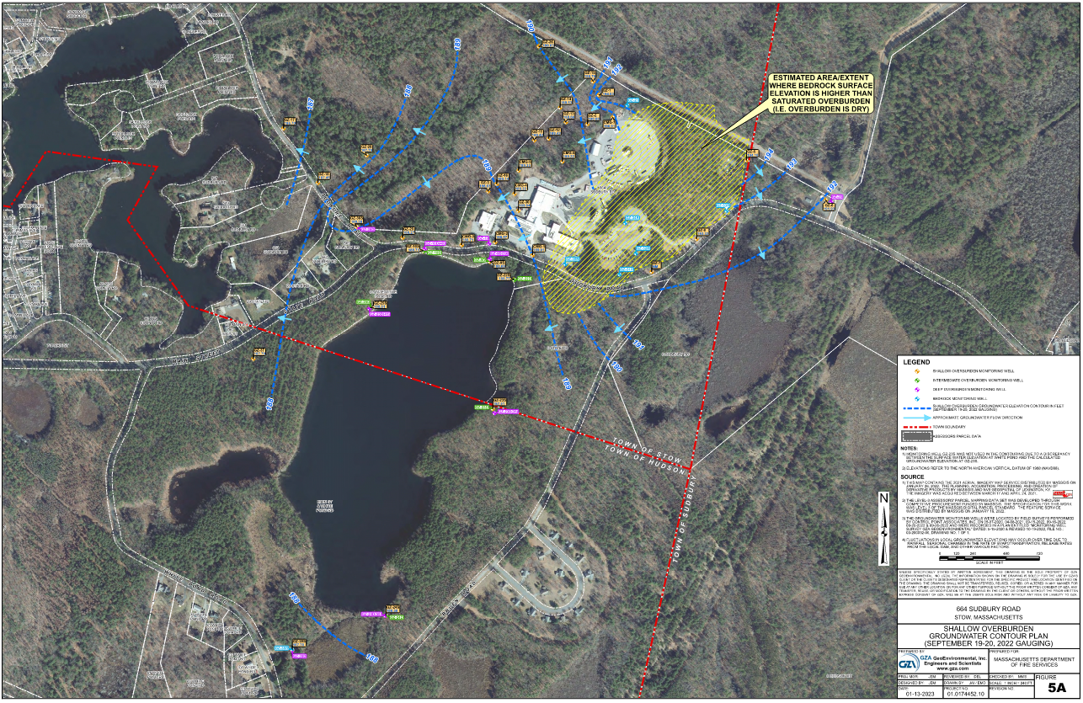
Potential Pathways
Highest Levels
Immediate Response Action Status Report No. 7, MA DFS Firefighting Academy, 664 Sudbury Road, Stow MA. Release Tracking Number 2-21045. MA Department of Environmental Protection, February 27, 2023. Prepared by GZA
DEP Figure 5A

Slide 14
Potential Actions
Test wells
Bottled Water or Treatment System
Examine funding assistance avenues
Participate in BOH Review

Slide 15
Local Well Testing Options PFAS Testing Quotes Obtained by LBA: Single EPA537.1 Test (18 compounds, 6 regulated, no blanks)
Company | Contact Info | Cost | Notes
Alpha Analytical (Westborough, MA) | Ethan Leighton, Kim Bailey 508-616-7924 | $ 316.25 | Includes courier pickup
RI Analytical (Hudson MA) | Paul Perrotti 978-568-004 | $ 299.00 | Includes courier pickup
SafeWell (Bolton, MA) | Dan Gafney 888-450-9355 | $ 350.00 (with group discount), $438 individual | Includes sampling and delivery to lab, MA PFAS6 test, would provide support including free zoom seminar for residents

Slide 16
In-Home Options for Avoiding PFAS
Activated Carbon Filtration
Reverse Osmosis
Bottled Water Service
Small scale – point of use (kitchen sink, for example)
General estimate from web research: $125-$325 for purchase and ~$100-$200/year filters
Whole house – treatment at point of entry
General estimate from web research: $300-$3,000 for purchase and ~$100-$200/year filters
Disposal of filters may become an issue
Used by municipal treatment facilities
Not allowed for in-home use in MA if waste is discharged to septic system
Narrow exception: If only treated at one tap, and waste is below standard for drinking water, may be ok.
Cost varies by household members and water use
Example: 20 gal/month with dispenser ~$45/mo. + $45 for first install.
DEP provides this service at their cost to 4-5 houses in the Basin 4 area

Slide 17
Funding Avenues
Based on 2019 study by GZA, DEP offered to pay for bottled water delivery to homes where PFAS was detected then (3rd & 4th basin).
State Lawsuit:
FROM AG Healey Sues Manufacturers of Toxic ‘Forever’ Chemicals for Contaminating Massachusetts Drinking Water and Damaging Natural Resources | Mass.gov
May 25, 2022: “Attorney General Maura Healey today sued 13 manufacturers of poly- and perfluoroalkyl (PFAS) “forever” chemicals used in firefighting foam for causing millions of dollars in damages to communities across Massachusetts by knowingly contaminating drinking water sources, groundwater, and other natural resources with highly toxic PFAS chemicals that pose a serious threat to public health and the environment. The suit also names two companies that shielded assets that should be available to remedy the damages caused by PFAS contamination.”
BOH Regulations: Homeowner’s expense
Homeowners become responsible for PFAS remediation for new wells, rehabilitated wells, and when transferring property
Not clear if homeowner obligation are any time water is sampled, or only during well construction, rehab, or property transfer
Are there other avenues, group discounts, volunteers to research this?

Slide 18
Stow Board of Health Draft Regulations
Access Draft Regulations:
https://www.stow-ma.gov/board-health/news/town-stow-private-well-regulations-draft
Offer comments and questions: health@stow-ma.gov
Comment Period ends 9/30/23
Should these regulations go into effect just as the new (more stringent) EPA regulations are coming out?
Have we explored other funding opportunities that may arise from pending legal actions and MADEP precedent for bottled water assistance?

Slide 19
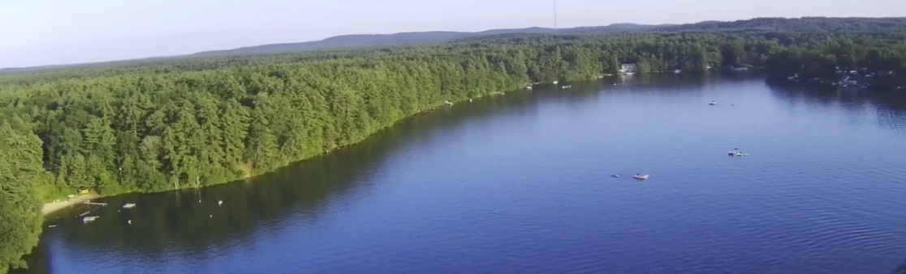
Call to Action
PFAS levels in Lake Boon already exceed current MADEP drinking water standards and imminent EPA standards
PFAS is toxic, but it is treatable
The cost of treatment can be high, and homeowners may be responsible
We have time to get ahead of this as a community if we take concerted action soon: Test/Fund/Treat
Households:
Test well water – Report to LBA for tracking if you wish
Consider Treatment Options
Read the pending Board of Health Regulations – send comments and questions if you wish (through September 30)
Community:
Are there funding options?
Are there group discounts on bottled water or treatment systems?
Are there volunteers familiar with environmental laws and/or state/federal funding programs?

